Slide 1
Maturity Models
IS465: Data Management and Governance

Slide 2
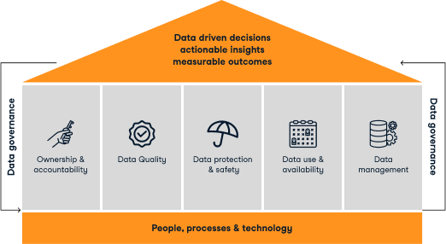
Assessing and Improving Data Management Capabilities
Data management and governance are critical for organizations to make informed decisions and achieve business objectives
Maturity models provide a framework for assessing and improving data management capabilities

Slide 3
Characteristics of Maturity Models
Define a set of maturity levels (e.g. initial, repeatable, defined, managed, optimized)
Assess data management capabilities across multiple dimensions (e.g. data quality, data security, data governance)
Provide a roadmap for improvement and a framework for measuring progress
Are industry-agnostic and can be applied to various organizations

Slide 4
Benefits
Improved data quality and reduced errors
Enhanced data security and compliance
Increased transparency and accountability
Better decision-making and business outcomes
Improved collaboration and communication across the organization
Identification of areas for cost reduction and optimization

Slide 5
Examples
CMMI's Data Management Maturity (DMM) Model
DM-BOK (Data Management Body of Knowledge) Maturity Model
Gartner's Data Management Maturity Model
IBM's Data Governance Maturity Model

Slide 6
What is a Data Management Maturity Model?
A Data Management Maturity Model is a framework or set of frameworks for evaluating the maturity level of an organization's data-related capabilities.
It may be used to identify opportunities for improvement through internal assessment (rather than by benchmarking against competitors).
It can serve as a yardstick for measuring capability development over time, evaluating progress against specific objectives, or understanding gaps to best practice.

Slide 7
How do I choose the best one for my organization?
Selecting the right model involves evaluating your organization's specific Data Management needs, industry requirements, organizational goals, and available resources.
Assess the strengths and weaknesses of each model within the context of your organization.
Look for alignment with your objectives, scalability, adaptability, ease of implementation, and potential fit for effectively addressing your specific Data Management challenges.

Slide 8
What are the key steps involved in implementing Maturity Model?
Implementing a Data Management Maturity Model typically involves numerous steps.
First, assess organizational needs, then select a suitable model, engage stakeholders, and plan for implementation.
Next, pilot the model in a specific data domain and evaluate the results before rolling out to the broader organization.
You may choose to seek external support if needed.
As you and your team conduct the assessment, it's important to adapt the chosen model based on your organization's needs.

Slide 9
Rationale for Conducting a DMMA
Knowing where you stand
Finding the gaps
Avoiding problems
Working smarter
Making better decisions
Alignment with objectives
Getting better over time
Improved data quality
Reduced data risk
Enhanced data-driven decision-making

Slide 10
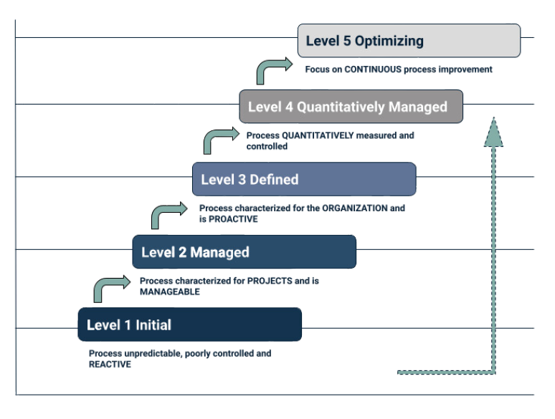
IBM's Data Governance Council Maturity Model

Slide 11
IBM's Data Governance Council Maturity Model
The model measures maturity on a scale of five levels of maturity.
It features 11 Data Governance categories composed of many subcategories.
These categories and subcategories can be individually assessed for their current maturity level, resulting in concrete steps for improvement.
Assessing domains individually allows for the DMMA to be better tailored to the specific needs of a given organization.
Best suited for:
an organization looking to establish, evaluate, or refine their Data Governance office; the model helps assess current practices and design effective programs aligned with industry standards

Slide 12
IBM's Data Governance Council Maturity Model
Benefits:
Builds on best practices contributed by real world data leaders
Each of the 11 separate data domains identified by the model can be individually assessed, contributing to the ability to prioritize the assessment based on immediate business need
Clear criteria for each of the five capability levels
Drawbacks:
Lacks implementation support and limited guidance on actual implementation
Establishes near-unobtainable standards for Level 4 (Quantitatively Managed) and Level 5 (Optimizing)

Slide 13
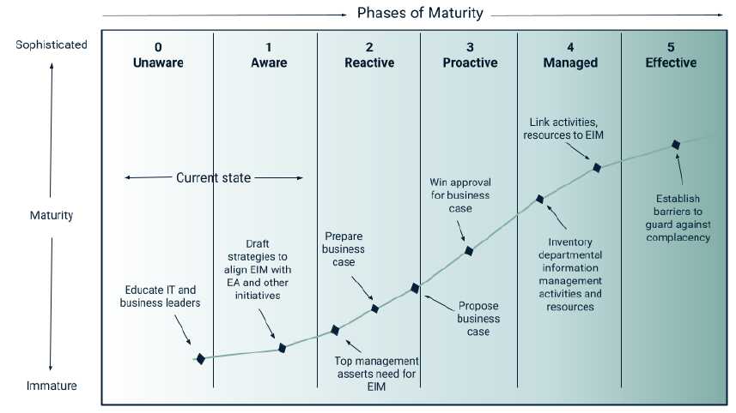
Gartner's Enterprise Information Management Maturity Model

Slide 14
Gartner's Enterprise Information Management Maturity Model
This model consists of six maturity phases, each delineating unique attributes and actionable steps.
Best suited for:
a Gartner customer who interested in assessing current maturity level, identifying areas for improvement, developing an EIM strategy, and measuring progress over time
Benefits:
Uses a straightforward six-level scale to measure maturity
Provides clear action items to achieve improvements
Backed by research-based best practices and support
Drawbacks:
Proprietary tool that requires a Gartner subscription, starting at $30,000 per year
Effectiveness relies on continued subscription and Gartner's periodic updates and revisions

Slide 15
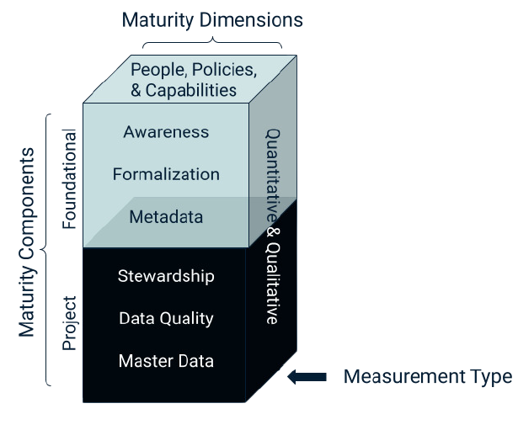
Stanford's Data Governance Maturity Model

Slide 16
Stanford's Data Governance Maturity Model
It serves as a good example of a model that provides practical guidance.
It focuses on Data Governance and separates the foundational competencies of this domain (awareness, formalization, and metadata) from project-related applications (such as stewardship, data quality, and master data).
In each section, it helps explain what motivates people, policies, and capabilities.
Best suited for:
an organization seeking to evaluate and enhance their Data Governance office

Slide 17
Stanford's Data Governance Maturity Model
Benefits:
Easy to understand and use
Practical and project-oriented
Adaptable to different organizational contexts, customizable to meet specific needs
Drawbacks:
May be difficult to scale and inappropriate for more complex organizations
Specific focus on Data Governance may not be helpful for organizations that are seeking a broader assessment of Data Management capabilities
Lack of clear recommendations based on result of assessment
Limited information and lack of support

Slide 18
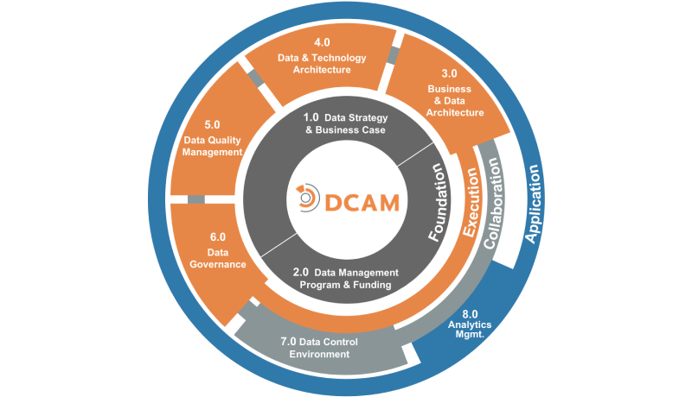
EDM Council's Data Management Capability Assessment Model (DCAM)

Slide 19
EDM Council's Data Management Capability Assessment Model (DCAM)
DCAM emerged as a framework for evaluating governance, quality, and architecture within data functions.
The framework helps organizations to identify Data Management areas needing improvement.
The DCAM framework is available for download and use exclusively by member firms of EDM Council for their in-house data management programs.
DCAM Authorized Partners are also entitled to use DCAM in their client assessments and engagements.
Best suited for:
an organization in the finance industry or another heavily regulated field, particularly one that may prefer support in assessment and implementation

Slide 20
EDM Council's Data Management Capability Assessment Model (DCAM)
Benefits:
Rigorous evaluation criteria
Benchmark Data Management practices against industry standards
Simplifies regulatory compliance
Potential support from DCAM-certified consultants
Drawbacks:
Potential lack of adaptability outside financial institutions
May not be appropriate for assessing the capabilities of smaller organizations
Relatively complex with components, capabilities, and sub-capabilities
Access requires becoming or partnering with a member of EDM Council

Slide 21
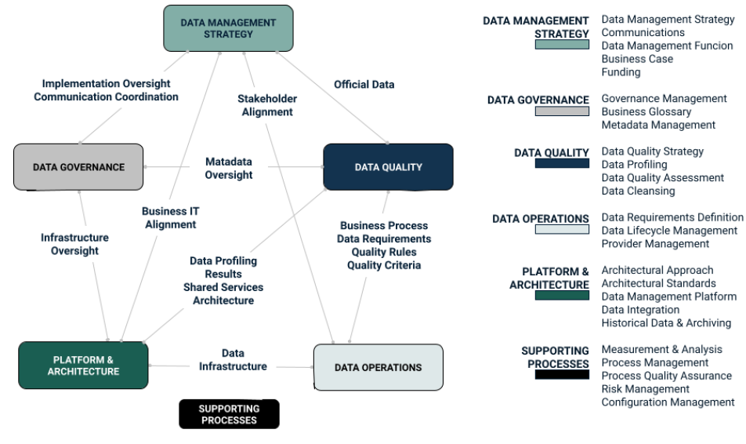
CMMI's Data Management Maturity (DMM) Model

Slide 22
CMMI's Data Management Maturity (DMM) Model
This framework provides a structured approach, delineating maturity levels and domains for assessing Data Management practices.
Its subsequent versions have evolved with technological advancements, gaining traction across various industries.
DMM was discontinued in January 2022.
It enables businesses to fortify Data Governance, adopt effective practices, and navigate complex data challenges, thereby demonstrating its ongoing relevance and adaptability.
Best suited for:
an organization seeking to understand alternative methodologies to compare fundamental principles of different approaches

Slide 23
CMMI's Data Management Maturity (DMM) Model
Benefits:
Based on how organizations typically build their Data Management program
Scores are based on the scope of the organization, so this model scales well for small organizations
Drawbacks:
No longer updated or supported by CMMI Institute

Slide 24
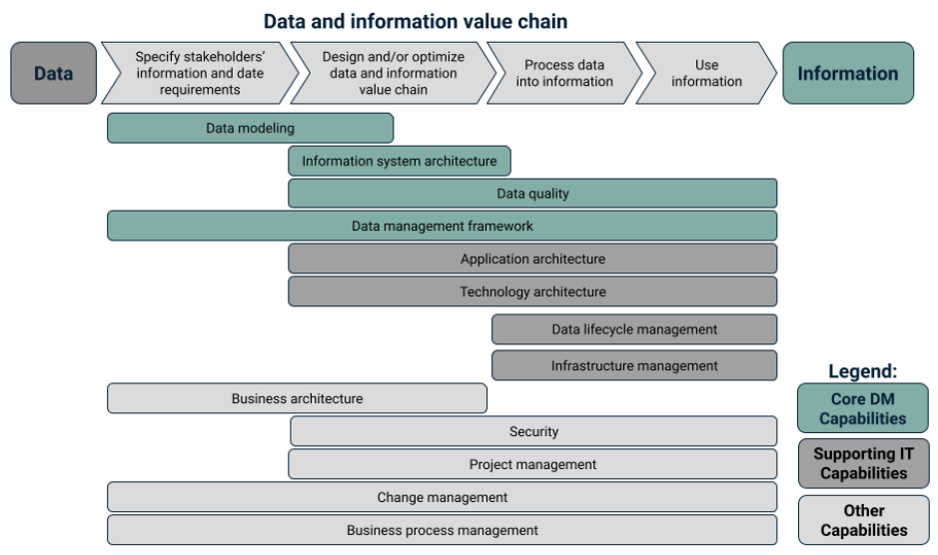
Data Crossroads' "Orange" Data Management Framework (DMF)

Slide 25
Data Crossroads' "Orange" Data Management Framework (DMF)
It is a combination of models, methods, and templates whose design has been informed by assessments of other common models such as DCAM to improve Data Management practices such as DMMAs.
Best suited for:
particularly useful for an organizations seeking to implement Data Management function from scratch or develop a new Data Management sub-capability due to comprehensive nature of DMF approach
Benefits:
Provides assessment of Data Management capabilities and maturity level
Supports implementation of Data Management function
Methodology to document data lineage and develop a knowledge graph of data assets
Drawbacks:
Broad scope may be less useful for practitioners seeking a straightforward capability assessment

Slide 26
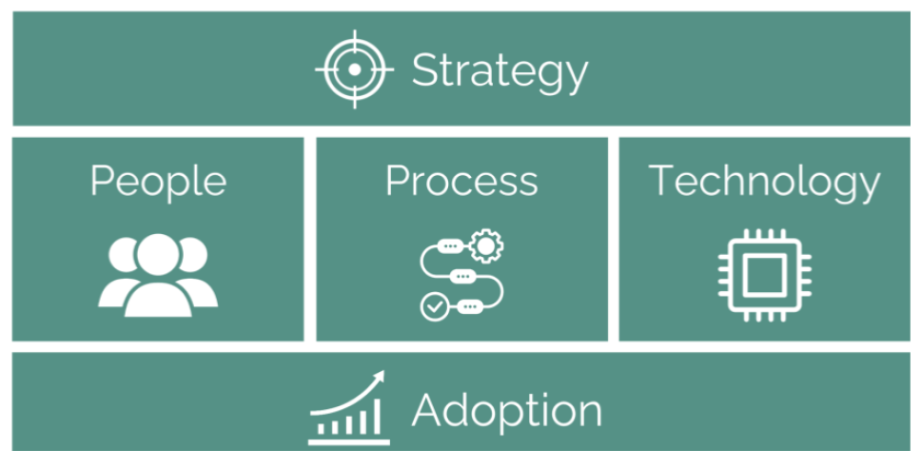
ZS' Data Maturity Compass (DMC)

Slide 27
ZS' Data Maturity Compass (DMC)
The Data Maturity Compass (DMC) is a largely automated DMMA system that uses Generative AI, standard benchmarks, and best practices to streamline the assessment process within organizations.
The DMC consists of three modules:
Input
Analysis
Insights
Best suited for:
an organization ready for an automated approach to data management maturity assessment

Slide 28
ZS' Data Maturity Compass (DMC)
Benefits:
Offers tailored recommendations in the form of strategic profiles
Logical roadmap stages toward improvement auto-generated in real time
Automated end-to-end process using cloud-native infrastructure that efficiently connects individual system components and automates key processes, reducing costs
Drawbacks:
Given the recent development of the model, there are limited customer reviews and a lack of proven effectiveness
Reliance on complex automations could generate unexpected results

Slide 29
Relevant Professional Certificates
Certified Data Governance Professional (CDGP)
Certified Data Manager (CDM)
Certified Business Intelligence Analyst (CBIA)
Certified Data Scientist (CDS)

Slide 30
Certified Data Governance Professional (CDGP)
The CDGP certification is designed for professionals who work in data governance, data management, data quality, data security, or related fields.
To become a CDGP certified professional, you'll need to meet the following requirements:
Education: A bachelor's degree or higher in a related field (e.g., computer science, information systems, business administration).
Experience: A minimum of 2 years of experience in data governance, data management, or a related field.
Training: Completion of a DGPA-approved data governance training program or equivalent.
Exam: Pass the CDGP certification exam, which consists of 100 multiple-choice questions that test your knowledge and skills in data governance.
Continuing education: Complete ongoing professional development requirements to maintain your certification.

Slide 31
Certified Data Governance Professional (CDGP)
What is the CDGP certification exam like?
The CDGP certification exam is a 2-hour, multiple-choice exam that covers the following topics:
Data Governance Frameworks and Models
Data Quality Management
Data Security and Privacy
Data Management and Architecture
Data Governance Policies and Procedures
Data Governance Roles and Responsibilities
Data Governance Metrics and Reporting

Slide 32
Certified Data Manager (CDM)
CDM Certification Requirements:
Education: Bachelor's degree or higher in a related field (e.g., computer science, information systems, business administration).
Experience: Minimum 2 years of experience in data management or a related field.
Training: Completion of a DAMA-approved data management training program or equivalent.
Exam: Pass the CDM certification exam, which consists of 100 multiple-choice questions.
CDM Certification Exam Topics:
Data Governance and Management
Data Architecture and Design
Data Security and Privacy
Data Quality and Integrity
Data Storage and Operations
Data Analytics and Reporting

Slide 33
Certified Business Intelligence Analyst (CBIA)
CBIA Certification Requirements:
Education: Bachelor's degree or higher in a related field (e.g., computer science, information systems, business administration).
Experience: Minimum 2 years of experience in business intelligence, data analysis, or a related field.
Training: Completion of a Business Intelligence Institute-approved training program or equivalent.
Exam: Pass the CBIA certification exam, which consists of 100 multiple-choice questions.
CBIA Certification Exam Topics:
Data Analysis and Modeling
Data Visualization and Reporting
Business Analytics and Decision Support
Data Mining and Machine Learning
Business Intelligence Tools and Technologies

Slide 34
Certified Data Scientist (CDS)
CDS Certification Requirements:
Education: Bachelor's degree or higher in a related field (e.g., computer science, statistics, mathematics).
Experience: Minimum 2 years of experience in data science, data analysis, or a related field.
Training: Completion of a DASCA-approved data science training program or equivalent.
Exam: Pass the CDS certification exam, which consists of 100 multiple-choice questions.
CDS Certification Exam Topics:
Data Acquisition and Preparation
Data Analysis and Modeling
Data Visualization and Communication
Machine Learning and AI
Big Data and NoSQL Databases
Data Science Tools and Technologies

